Slide 1
Team B Group 2​
Preliminary Results​
Gene Prediction & Functional Annotation Pipeline
Group members: Zahra, Aditi, Fanshi

Slide 2
Agenda
Project context & role in pipeline
Dataset received from Group 1
Annotation pipeline design
Preliminary results

Slide 3
Dataset overview
We received an assembled bacterial genome from Group 1. This serves as the input to our structural annotation workflow.
Metric | 🧬 Bea3b88bb9 | 🧬 Bfe6f82f31
Genome size | 2.06 Mb | 2.08 Mb
Number of Contigs | 198 | 197
N50 | 18.1 kb | 17.1 kb
File format | FASTA (.fasta) | FASTA (.fasta)

Slide 4
Pipeline + tools
Phase 2
Genome Assembly (.fasta)
Phase 1
CDS Prediction
Prodigal vs GLIMMER vs GeneMarkS-2
rRNA detection
RNAmmer vs Barrnap
Protein FASTA (.faa)
Extract 16S rRNA
Phase 3
BLASTn (core_nt) → Species Identification
Functional Annotation
eggnog-mapper vs InterProScan

Slide 5
Why rRNA Detection?
rRNA genes are essential bacterial markers
16S rRNA is used for species identification
We compare two structural annotation tools
Goal: balance accuracy vs computational cost

Slide 6
Tools: RNAmmer vs Barrnap
By comparing Barrnap vs RNAmmer we want to determine whether RNAmmer’s computational overhead is justified for draft genomes, or if Barrnap’s speed makes it the better choice for our final pipeline
Feature | RNAmmer | Barrnap
HMM Engine | HMMER2 (legacy) | HMMER3 (modern)
Installation | Manual | Conda
Speed | Slow | Fast
Status | Older | Actively maintained

Slide 7
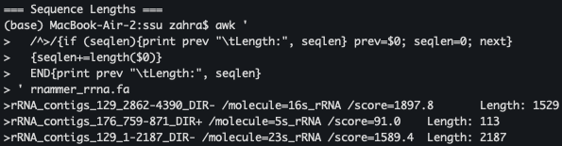
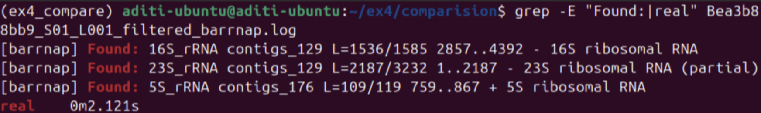

rRNA Detection
Both tools detect the same rRNA complement, but Barrnap is ~23× faster.
(Bea3b88bb9)
Feature | RNAmmer | Barrnap
16S | 1529 bp | 1585 bp
23S | 2187 bp | 3232 bp
5S | 113 bp | 119 bp
Total rRNA | 3 | 3
Runtime | 48.98 s | 2.12 s

Slide 8
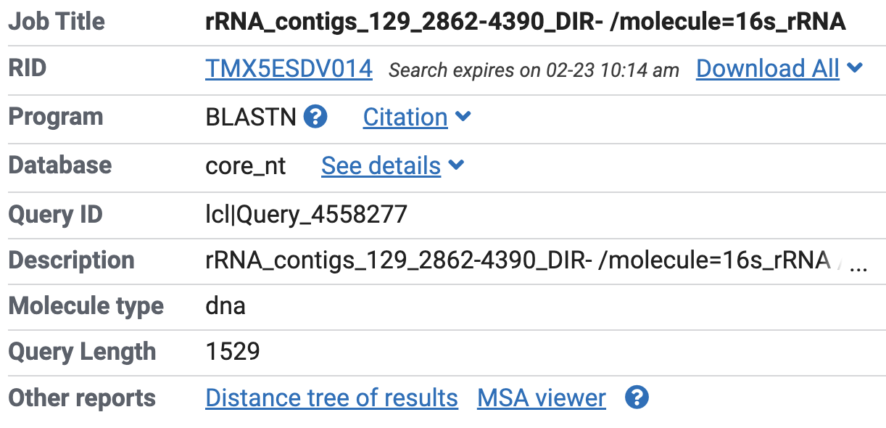
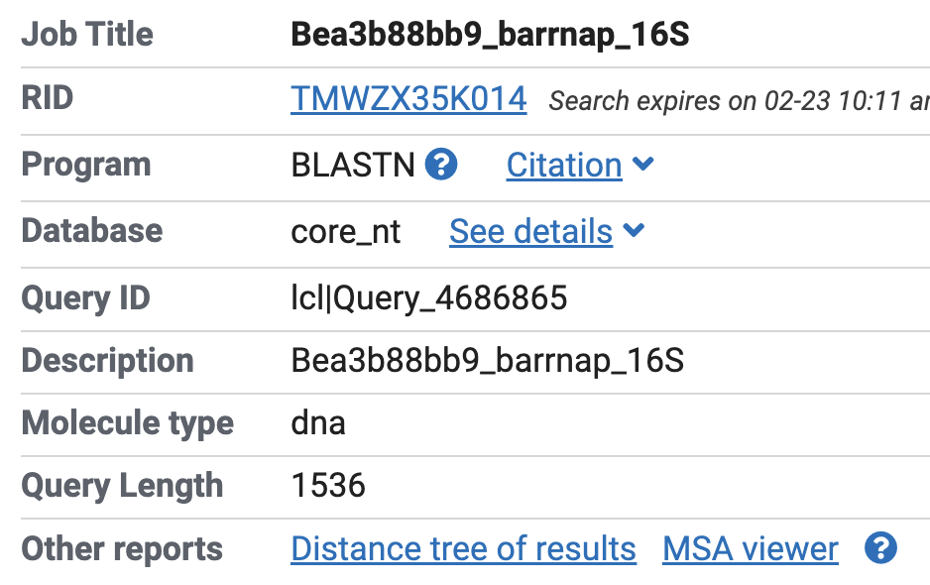
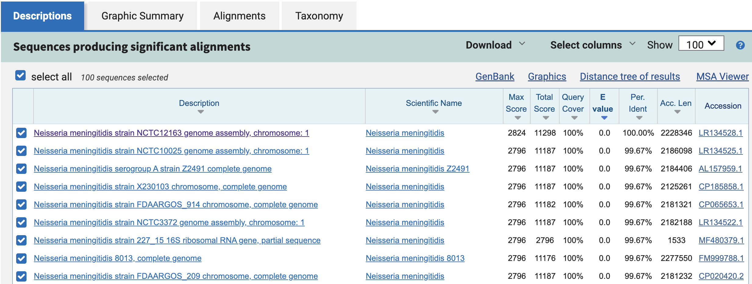
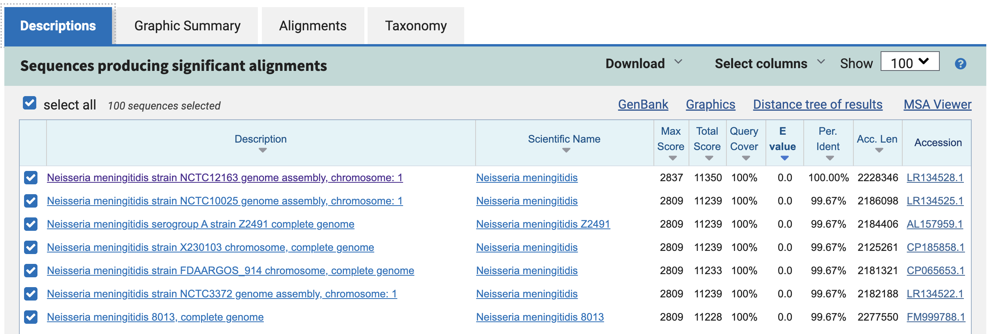
BLASTn : Species Identification
(Using 16S rRNA)
RNAmmer
Tool | 16S Length | Top Hit | Identity | Coverage
RNAmmer | 1529 bp | N. meningitidis | 100% | 100%
Barrnap | 1536 bp | N. meningitidis | 100% | 100%

Slide 9
Final Evaluation
Phase 1 Conclusion
Structural output: Equivalent
Species identification: Identical
Computational cost: Barrnap significantly faster
Selected tool for final pipeline: Barrnap

Slide 10
Coding Sequence (CDS) Prediction
Identify protein-coding genes
Generate protein FASTA (.faa)
Input for functional annotation
Compare three gene prediction tools

Slide 11
Tool Architecture
Tool | Model Type | Strength
Prodigal | Self-training heuristic | Fast, optimized for bacteria
GLIMMER | Interpolated Markov model | Classical gene finder
GeneMarkS-2 | Self-training HMM | High accuracy

Slide 12
Tool Architecture
GLIMMER (IMM): High sensitivity; may overpredict short or overlapping ORFs.
GeneMarkS-2 (HMM): Self-training (–ES mode); adapts to genome GC content.
Prodigal (Dynamic Programming): Conservative gene boundaries; directly outputs translated proteins (.faa).
Comparison Strategy:
Establish consensus by comparing gene counts and average CDS length. The tool that maintains realistic bacterial coding density (~85–90%) with lower runtime will be selected for Phase 3.
Metric | Prodigal (v2.6.3) | GLIMMER (v3.02) | GeneMarkS-2 (v1.15_1.25_lic)
Bea3b88bb9 | 1,966 | 2,209 | 2,170
Bfe6f82f31 | 1,982 | 2,209 | 2,174
Bea Execution Time | 0m4.078s | 0m5.133s | 0m11s
Bfe Execution Time | 0m2.494s | 0m3.563s | 0m12s
Output Files Generated | .gff, .faa, .log | .predict, .icm, .log | .gff, .faa, .fnn
Primary Algorithm | Dynamic Programming | Interpolated Markov Models | Hidden Markov Models

Slide 13
CDS Count
Dataset |  | Tool | Total CDS | Avg Length (bp)
Bea3b88bb9 |  | Prodigal | 1966 | 874
Bea3b88bb9 |  | GeneMarkS-2 | 2170 | 810
Bea3b88bb9 |  | GLIMMER | 2209 | 897
GLIMMER predicted the highest number of genes (2209), suggesting possible overprediction.
GeneMarkS-2 showed intermediate gene counts (~2170) with balanced predictions.
Prodigal predicted the fewest genes (~1966–1982) with consistent lengths, indicating a more conservative approach.
Ease of execution
GeneMarkS-2: reliance on Docker and Rosetta added unnecessary infrastructure overhead
Notes:
Observations
GLIMMER predicted the highest number of genes (2209 CDS) and slightly longer average gene lengths, suggesting possible overprediction of overlapping ORFs.
GeneMarkS-2 produced an intermediate gene count (~2170 CDS) with slightly shorter average lengths, indicating a more balanced prediction compared to GLIMMER.
Prodigal predicted the lowest number of genes (~1966–1982 CDS) with consistent average lengths (~874 bp), suggesting a more conservative gene-calling approach.

Slide 14
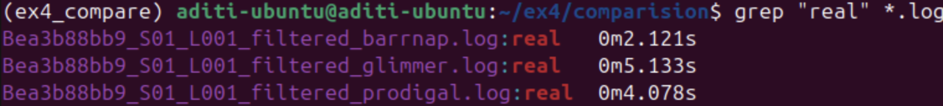
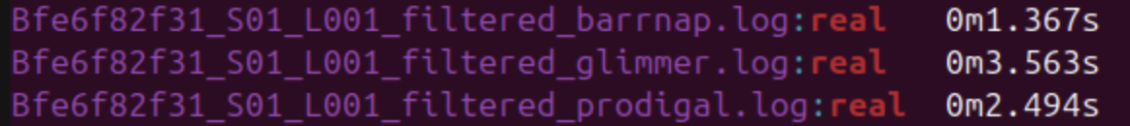
Runtime Comparison
Prodigal demonstrated consistently faster runtime than Glimmer across both genomes.
Genome | Prodigal (s) | Glimmer (s) | GeneMarkS-2
Bea3b88bb9 | 4.08 | 5.13 | 11
Bfe6f82f31 | 2.49 | 3.56 | 12
Average | 3.29 | 4.35 | 11.5

Slide 15
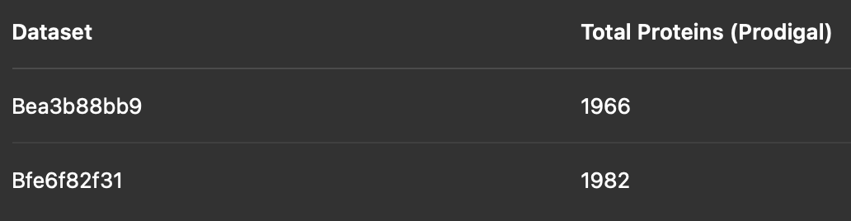
Functional Annotation
Input:
Prodigal predicted proteins (.faa)
Tools used:
InterProScan (domain-based) → What biological process is this protein involved in?”
eggNOG-mapper (orthology-based) → Which structural domains enable this function

Slide 16
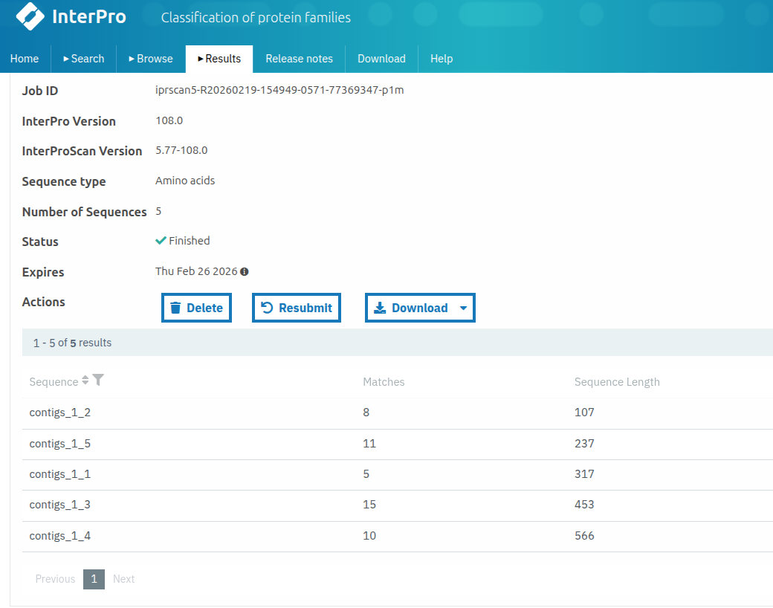
InterPro Results Summary
InterPro
Total proteins analyzed: 5
Total domain/motif hits detected: 49
Proteins with ≥1 annotation: 5 / 5 (100% coverage in subset)
Average hits per protein: 9.8
InterProScan provides sub-gene level structural annotation
Multiple domain predictions per protein
High structural resolution
Subset demonstrates strong domain detection capability

Slide 17
EggNOG Functional Annotation Results
Dataset | Bea3b88bb9 | Bfe6f82f31
Total proteins input | 1966 | 1982
Proteins with eggNOG ortholog assignment | 1918 | 1935
Proteins with COG category | 1897 | 1912
Proteins with KEGG pathway | 1764 | 1783
Proteins with EC number | 842 | 859
Annotation Coverage | (1918/1966)*100 = 97.5% | (1935/1982)*100 = 97.6%

Slide 18
Functional Annotation Strategy Comparison
Feature | eggNOG-mapper | InterProScan
Input size | Full proteome (~2,170 proteins) | Representative subset (5 proteins)
Annotation scale | Genome-wide | Per-protein structural analysis
Coverage (this study) | ~87% proteome annotated | 100% within subset
Main output type | Ortholog groups, COG, KEGG, EC | Domains, motifs, structural signatures
Biological resolution | Functional pathway level | Domain / structural level
Primary strength | Metabolic context | Architectural precision
Role in pipeline | Global functional assignment | Structural validation & refinement
The high eggNOG annotation rate and InterPro domain richness confirm that our CDS predictions are biologically consistent and suitable for downstream functional and comparative analyses.

Slide 19
Thanks for your attention

